Slide 1
SQL Server Backup with encryption
Zularbine Kamal
MD and CEO, Ardites Bangladesh Ltd.

Slide 2
Why backup
To prevent Data loss (physical damage, hacking, virus etc)
Protect losses in brand reputation, customer loyalty, and customer trust.
Extra protection of your system.
Customer requests for an old data
Migrate data to a new system.

Slide 3
Backup basics , 3-2-1 rule
Keep at least three (3) copies of your data (so no single event will destroy all copies);
Store the data in at least two (2) different formats (i.e. disk, tape, cloud, etc.);
Keep one (1) copy offsite to protect against fire, flood, theft, and other physical disasters.

Slide 4
What is backup encryption
Encryption is supported for backups done by SQL Server Managed Backup, which provides additional security for off-site backups.
To encrypt during backup, you must specify an encryption algorithm, and an encryptor to secure the encryption key. The following are the supported encryption options:
Encryption Algorithm: The supported encryption algorithms are: AES 128, AES 192, AES 256, and Triple DES
Encryptor: A certificate and asymmetric Key

Slide 5
Data life

Slide 6
Why use backup encryption
Encrypting the database backups helps secure the data: SQL Server provides the option to encrypt the backup data while creating a backup.
Encryption is supported for backups done by SQL Server Managed Backup to Microsoft Azure, which provides additional security for off-site backups.
This feature supports multiple encryption algorithms up to AES 256 bit. This gives you the option to select an algorithm that aligns with your requirements.

Slide 7
Backup encryption operation plan
- Create a Database Master Key of the master database.
- Create a Backup Certificate.
- Backup the database
It is always nice to have a backup of the master key that we’ve just created.

Slide 8
DEMO

Slide 9
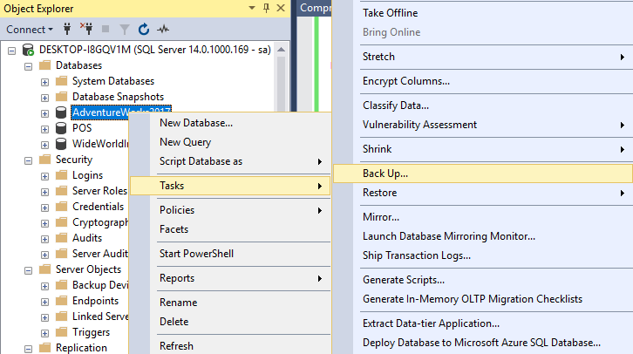
How :full database backup
Step :1 Expand Databases and select a database which you want to backup
Step :2 Right-click the database, point to Tasks, and then click Back Up. The Back Up Database dialog box appears.

Slide 10
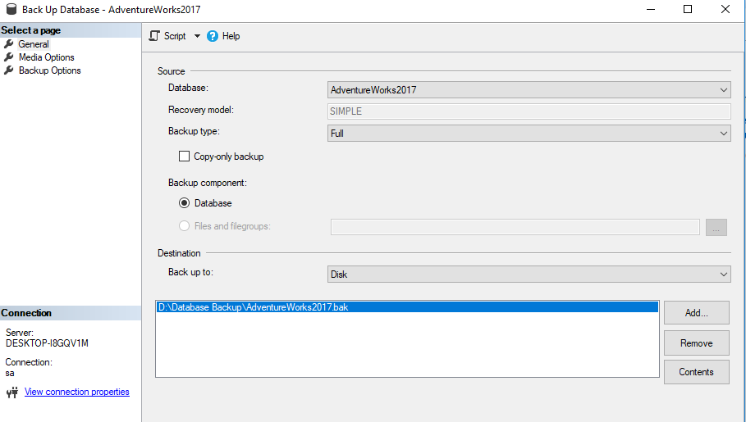
How: in general page
In the Database drop-down list, verify the database name. Optionally, you can select a different database from the list.
The Recovery model text box is for reference only. You can perform a database backup for any recovery model (FULL, BULK_LOGGED, or SIMPLE).
In the Backup type drop-down list, select Full.
Optionally, you can select the Copy-only backup checkbox to create a copy-only backup. A copy-only backup is not available for the Differential backup type.
For Backup component, select the Database radio button.
In the Destination section, use the Back up to drop-down list to select the backup destination. Click Add to add additional backup projects and/or destinations.
To view the contents of an existing backup destination, select it and click Contents.

Slide 11
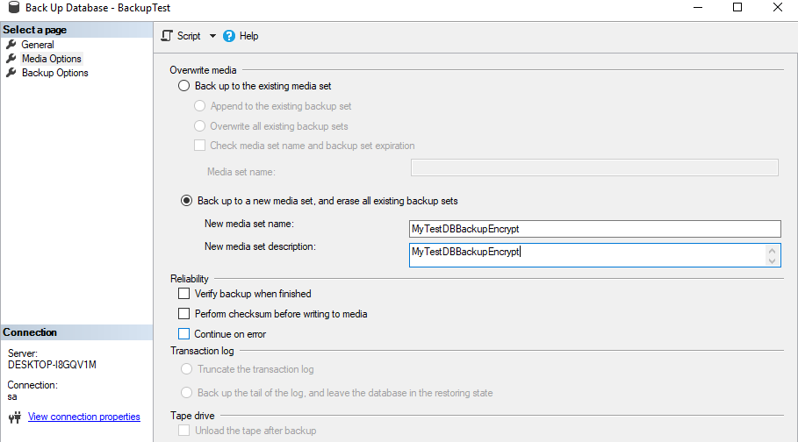
How: in media option page
To view or select the media options, click Media Options in the Select a page pane.
Back up to a new media set, and erase all existing backup sets
Enter a new media set name and a media set description
In the Reliability section, optionally check:
Verify backup when finished.
Perform checksum before writing to media. For information on checksums
Continue on error.

Slide 12
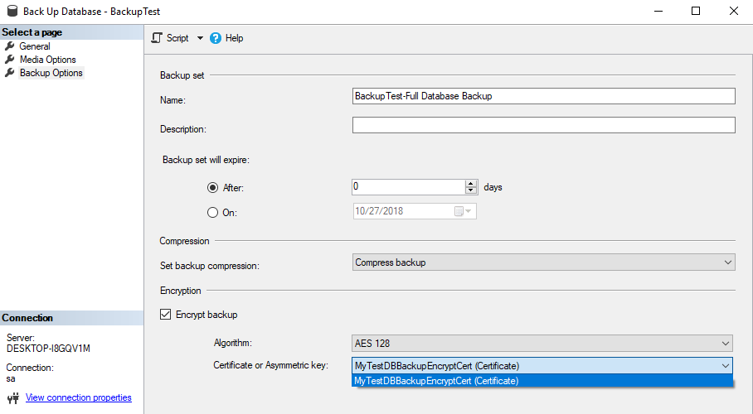
How: In backup Options Page
To view or select the backup options, click Backup Options in the Select a page pane.
In the Name text box either accept the default backup set name, or enter a different name for the backup set.
In the Description text box, you can optionally enter a description of the backup set.
Specify when the backup set will expire and can be overwritten without explicitly skipping verification of the expiration data
In the Compression section, use the Set backup compression drop-down list to select the desired compression level.
In the Encryption section, check Encrypt backup checkbox. Use the Algorithm drop-down list to select an encryption algorithm. Use the Certificate or Asymmetric key drop-down list, to select an existing Certificate or Asymmetric key.
Encryption is supported in SQL Server 2014 or later.

Slide 13
T-SQL

Slide 14
How :backup with t-sql
Step :1 Create a Databases with a master key using the script.
When it is created, the master key is encrypted by using the AES_256 algorithm and a user-supplied password.
------------------------------Creates a database master key--------------------------------
USE master;
GO
CREATE MASTER KEY ENCRYPTION BY PASSWORD = '<master key password>';
GO; GO

Slide 15
How :backup with t-sql
Step :2 Create a Backup Certificate
-------------------------------Create a Backup Certificate-----------------------------------
Use Master
GO
CREATE CERTIFICATE MyTestDBBackupEncryptCert
WITH SUBJECT = 'MyTestDB Backup Encryption Certificate';
GO

Slide 16
How :backup with t-sql
Step :3 Backup the database
------------------Backup the database with encryption----------------
BACKUP DATABASE BackupTest
TO DISK = N'D:\Database Backup\BackupTest_with_Encryption.bak'
WITH
COMPRESSION,
ENCRYPTION
(
ALGORITHM = AES_256,
SERVER CERTIFICATE = MyTestDBBackupEncryptCert
),
STATS = 10
GO

Slide 17
How :backup with t-sql
Step :4 Backup the database without compression and encryption
-----------------Backup the database without compression and encryption---------------
BACKUP DATABASE BackupTest
TO DISK = 'D:\Database Backup\BackupTest_with_Noencryption.bak';
GO

Slide 18
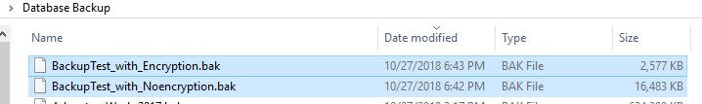
How :backup with t-sql
Step :5 Compare the database size with and without encryption and compression.

Slide 19
LIMITATIONS

Slide 20
Limitation and recommendation
Limitations Of Encrypted Database Backup:
The following are restrictions that apply to the encryption options:
If you are using asymmetric key to encrypt the backup data, only asymmetric keys residing in the EKM provider are supported.
SQL Server Express and SQL Server Web do not support encryption during backup.
However restoring from an encrypted backup to an instance of SQL Server Express or SQL Server Web is supported.
Previous versions of SQL Server cannot read encrypted backups.
Appending to an existing backup set option is not supported for encrypted backups.

Slide 21
THANK YOU!

